Slide 1
PLANT DISEASE IDENTIFICATION
By ali nodahy

Slide 2
In this project we aim to identify the category of foliar disease in the leaves of trees. Primarily, we aim to identify whether a leaf belong to healthy, multiple-diseased, scab or rust category, using Image Processing and Machine Learning.
the dataset contain 1821 training images and 1,821 testing images
So we have 4 class:{
1: healthy
2:scrab
3:rust
4: multiple-diseased}

Slide 3
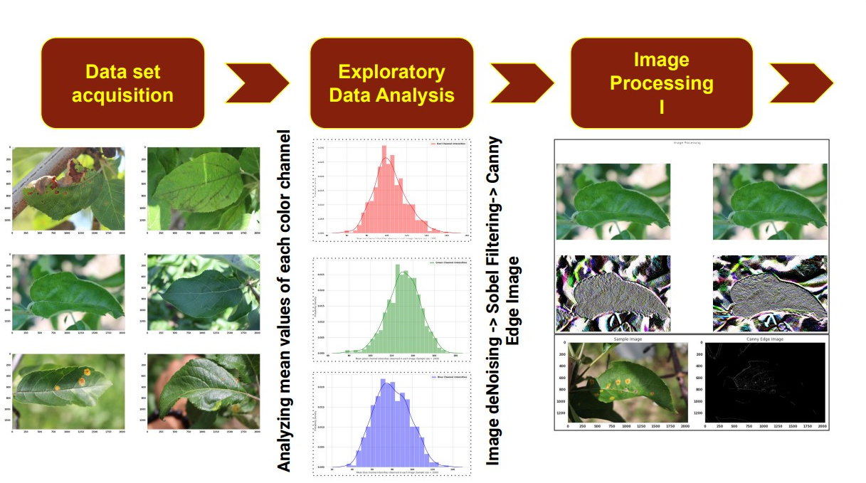

Slide 4
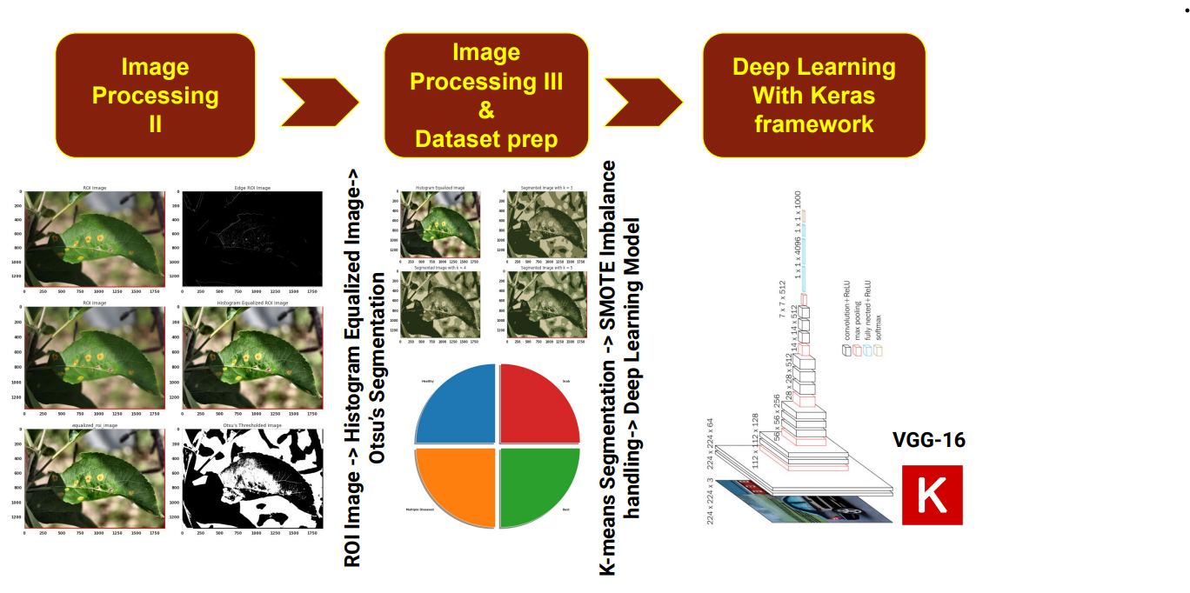

Slide 5
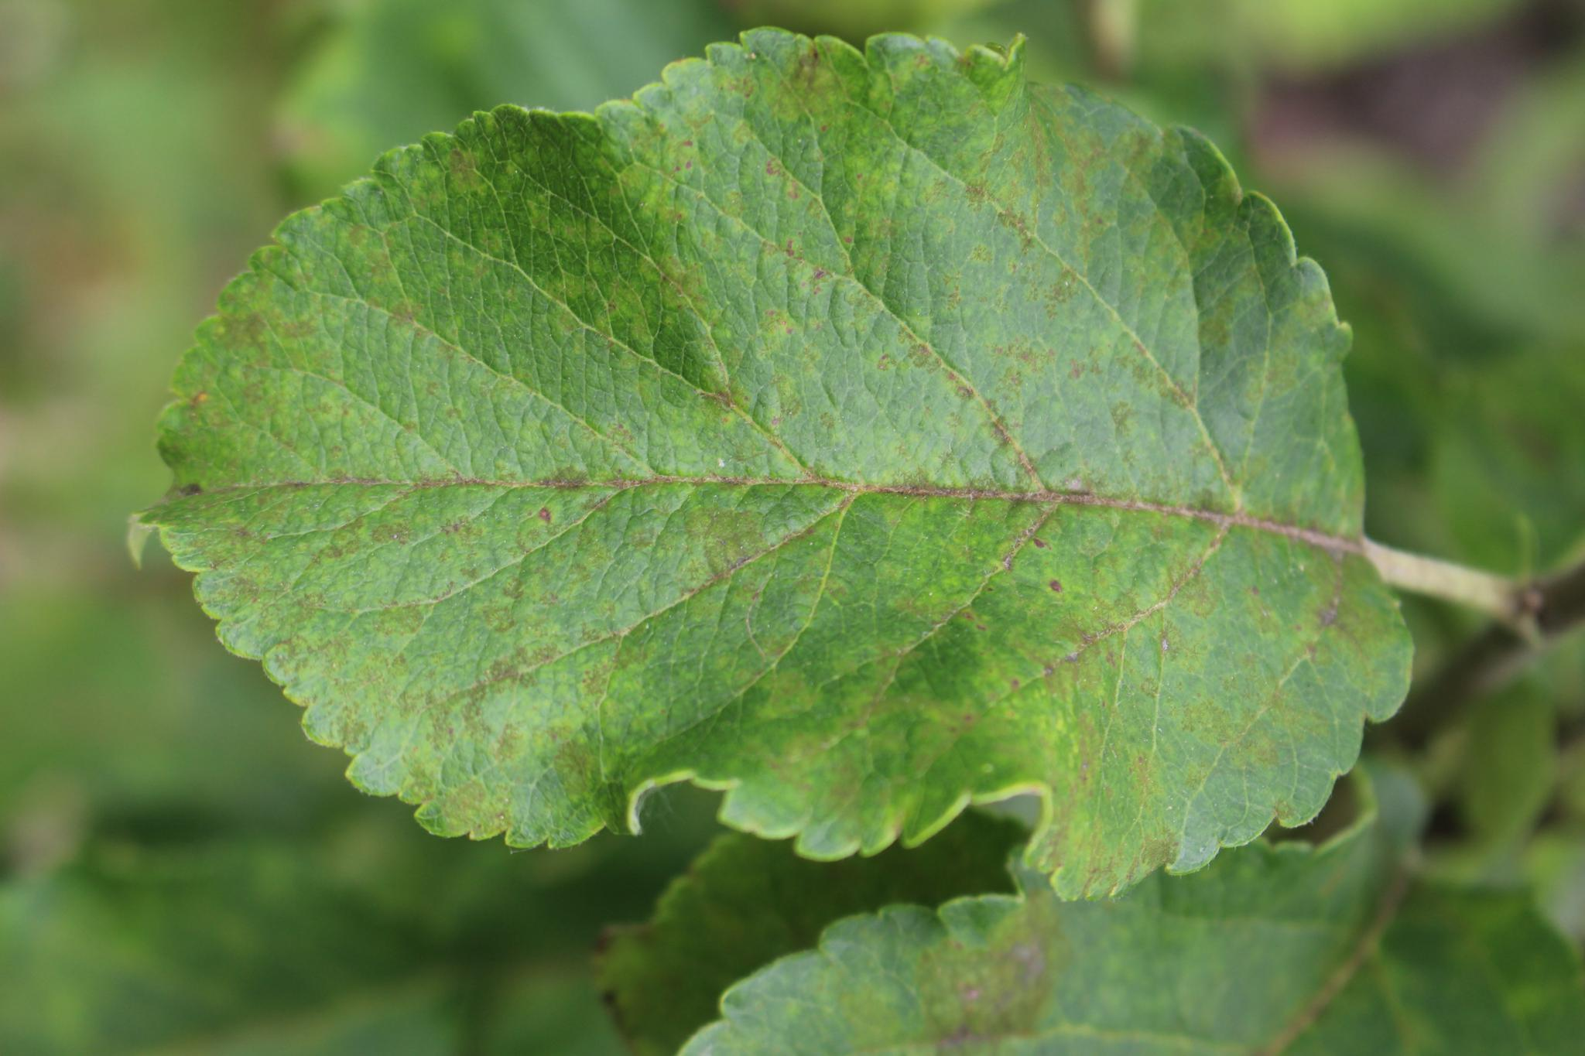
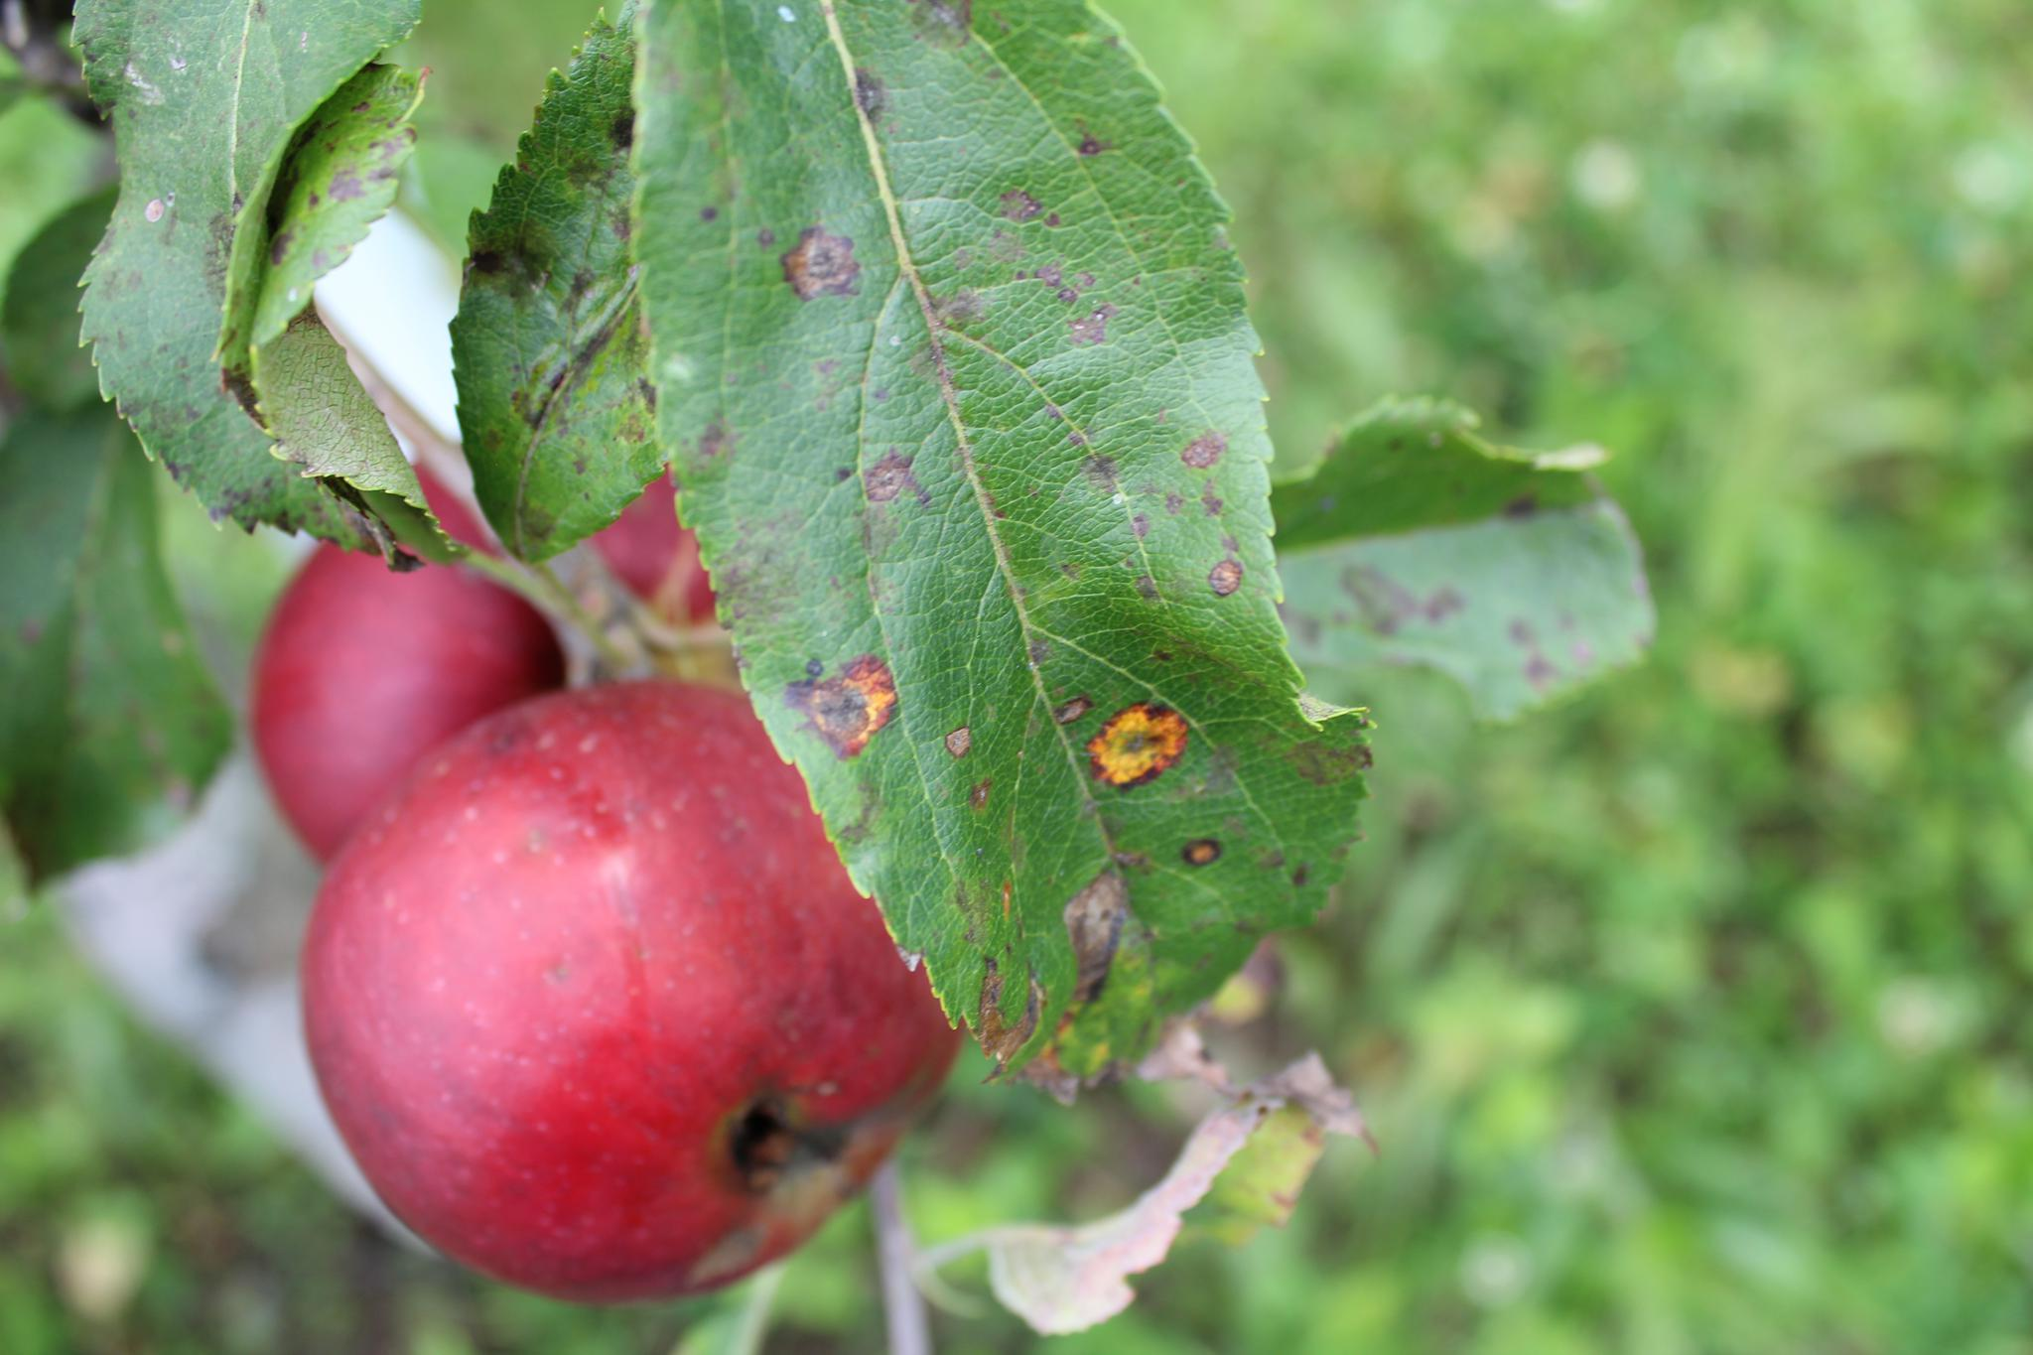
Some sample image for training test
We have manually captured 3,651 high-quality, real-life symptom images of multiple foliar diseases, with variable illumination, angles, surfaces, and noise.
We also trained an off-the-shelf convolutional neural network (CNN) on this data for disease classification and achieved 97% accuracy on a held-out test set

Slide 6





Libraries used
numpy
Matplotlib
Tensorflow-Keras
seaborn
OpenCV

Slide 7
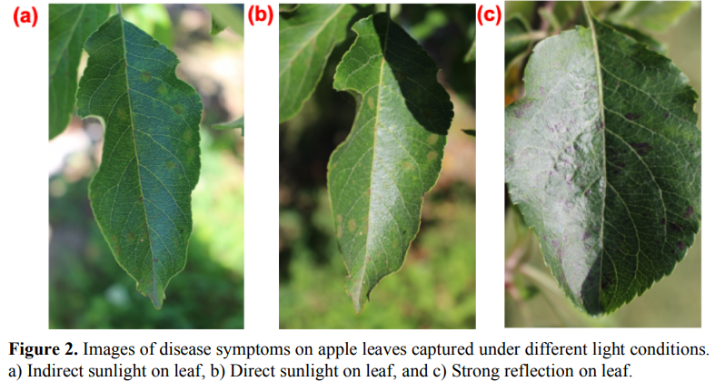
Some nose mybe in some photo like:
Caption01 appears here
Caption03 appears here
Caption04 appears here

Slide 8
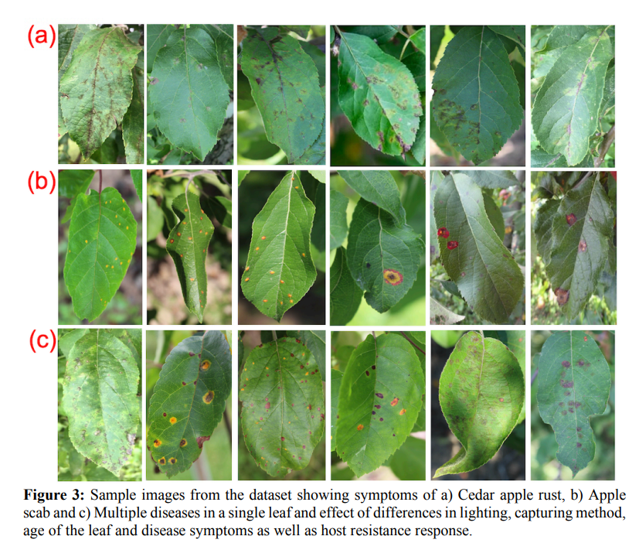

Sample image from dataset show classification

Slide 9
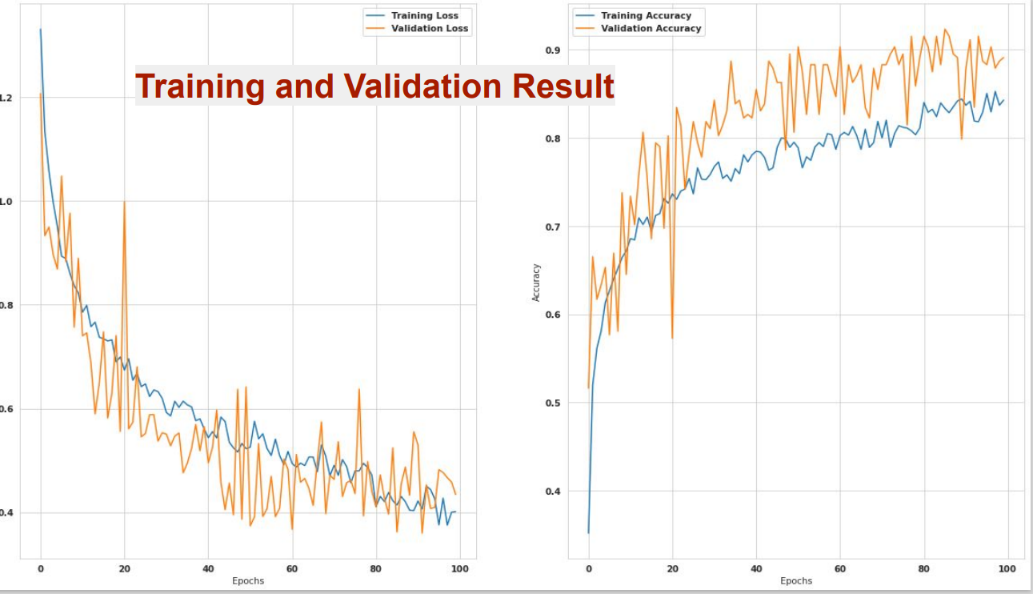
The complexities of the dataset were increased by including
(1) Imbalanced dataset of different disease categories,
(2) Non homogeneous background of images,
(3) Images taken at different times of day,
(4) Images from different physiological age of the plants,
(5) Multiple diseases in the same image, and
(6) Different focus of the images.
with all this we got 97% accuracy base on paper

Slide 10
Thank You

